Slide 1
Modeling the Residential EV Charging Load
Presented by: Lily Gittoes
July 24, 2026

Slide 2
Presentation Agenda
Step through how we model the EV load in ResStock 2024:
EV adoption
Driving profiles
Simulating annual travel
EV characteristics
EV at home/away and discharge
Charging policies
Along the way:
Modeling assumptions
Maryland simulation results for baseline ResStock 2024 scenario
Comparison to ResStock 2025 EV modeling

Slide 3
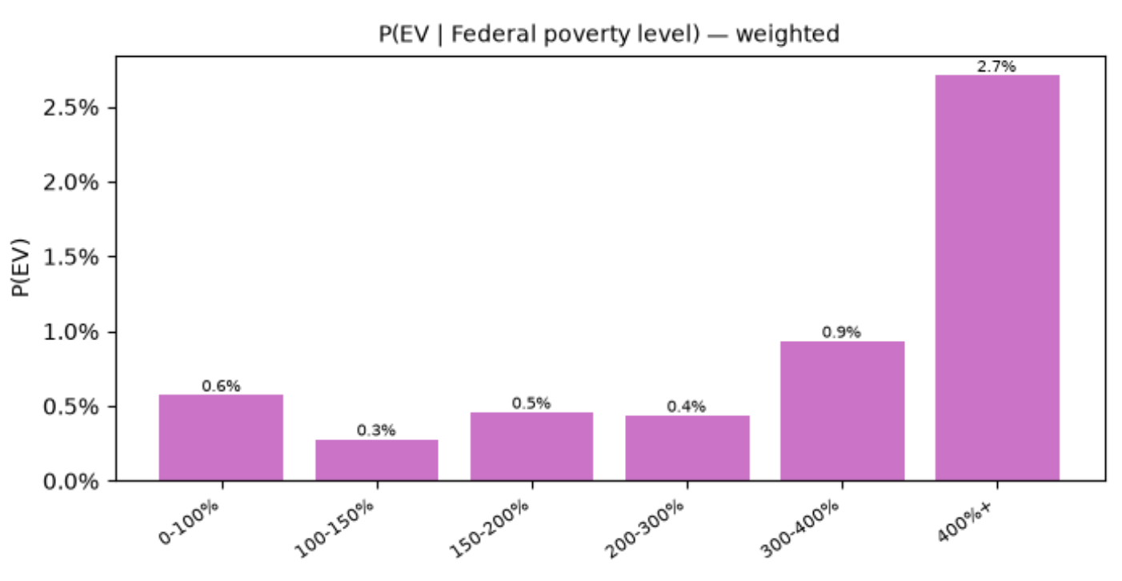
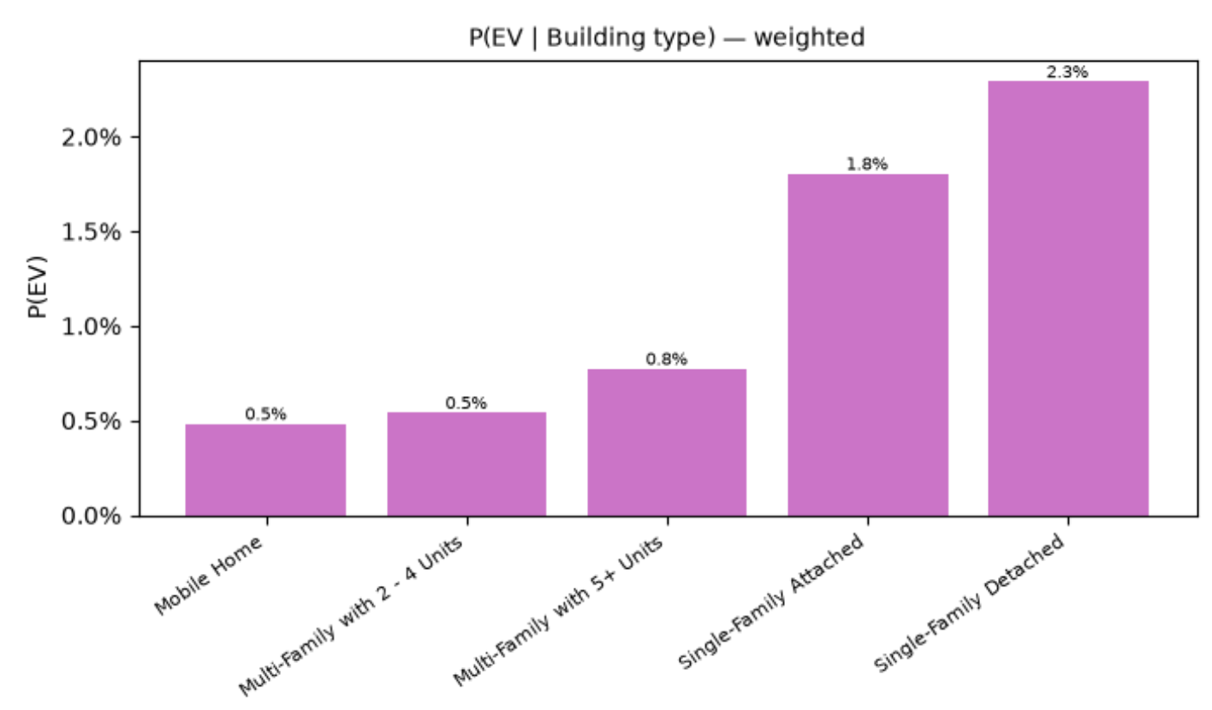
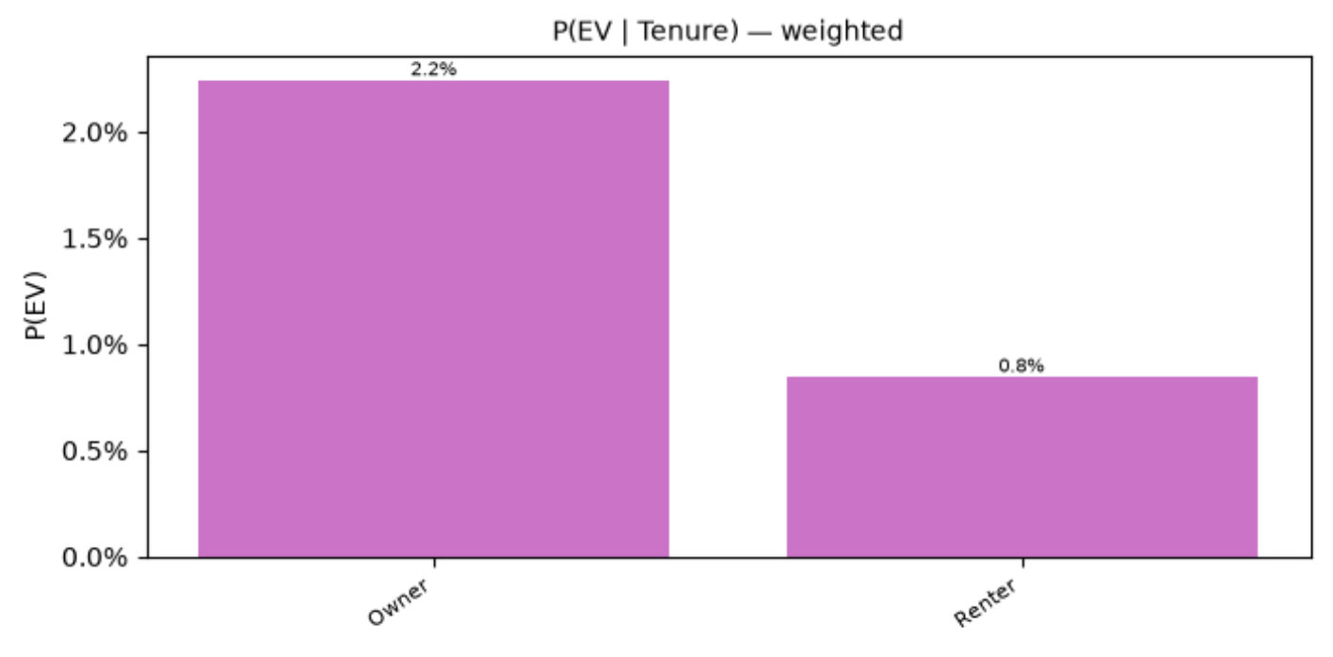
Step 1: Model EV Adoption
ResStock (2025) provides EV ownership rates by segment:
Federal poverty level (FPL)
Building type
Tenure
PUMA
P(own EV | segment)
Plots of EV ownership rates by segment (weighted by PUMS source weights):

Slide 4
Step 1: Model EV Adoption
ResStock (2024) metadata_df (MD):
Bernoulli sampling!
bldg_id | fpl | building_type | puma | tenure | P(EV) | EV
3870 | 400%+ | SF Detached | MD, 01001 | Owner | 0.047 | 1
142 | 400%+ | SF Detached | MD, 01203 | Owner | 0.029 | 0
295 | 200-300% | SF Detached | MD, 01600 | Renter | 0.002 | 0
Assumptions:
Each household has at most 1 EV
Vacant units do not have EVs
Scaling to future EV adoption:
TEMPO model outputs EV stock in 3 scenarios (baseline, high electrification, and all EV sales by 2035)
ResStock (2025) EV adoption rates are aligned with TEMPO baseline year (2023)
Notes:
Add more visualizations along the way. Like visualize demographic data influencing trip profiles for example
Representation of load shifting under different assumptions

Slide 5
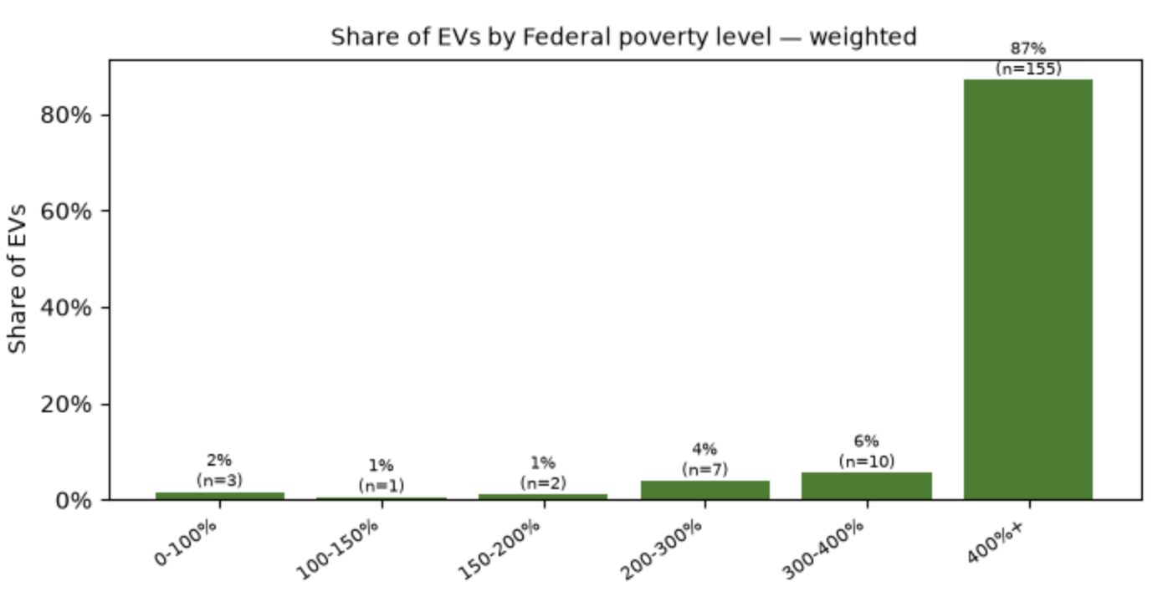
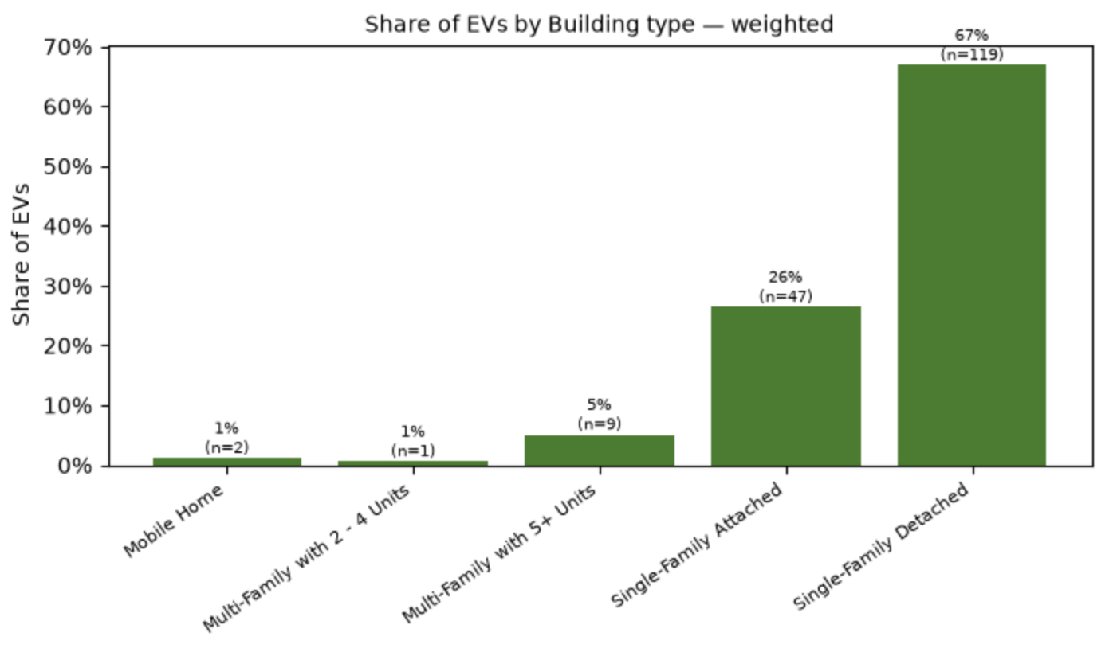
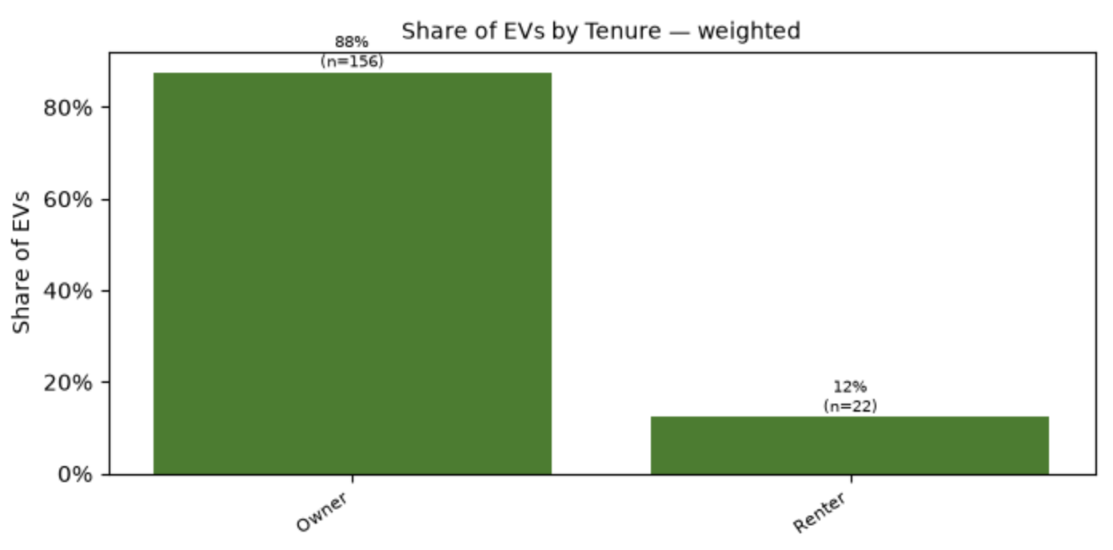
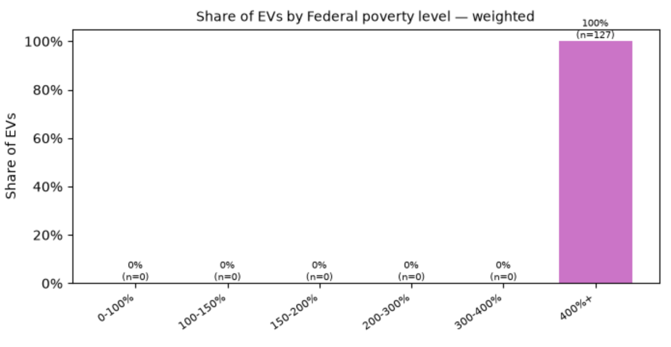
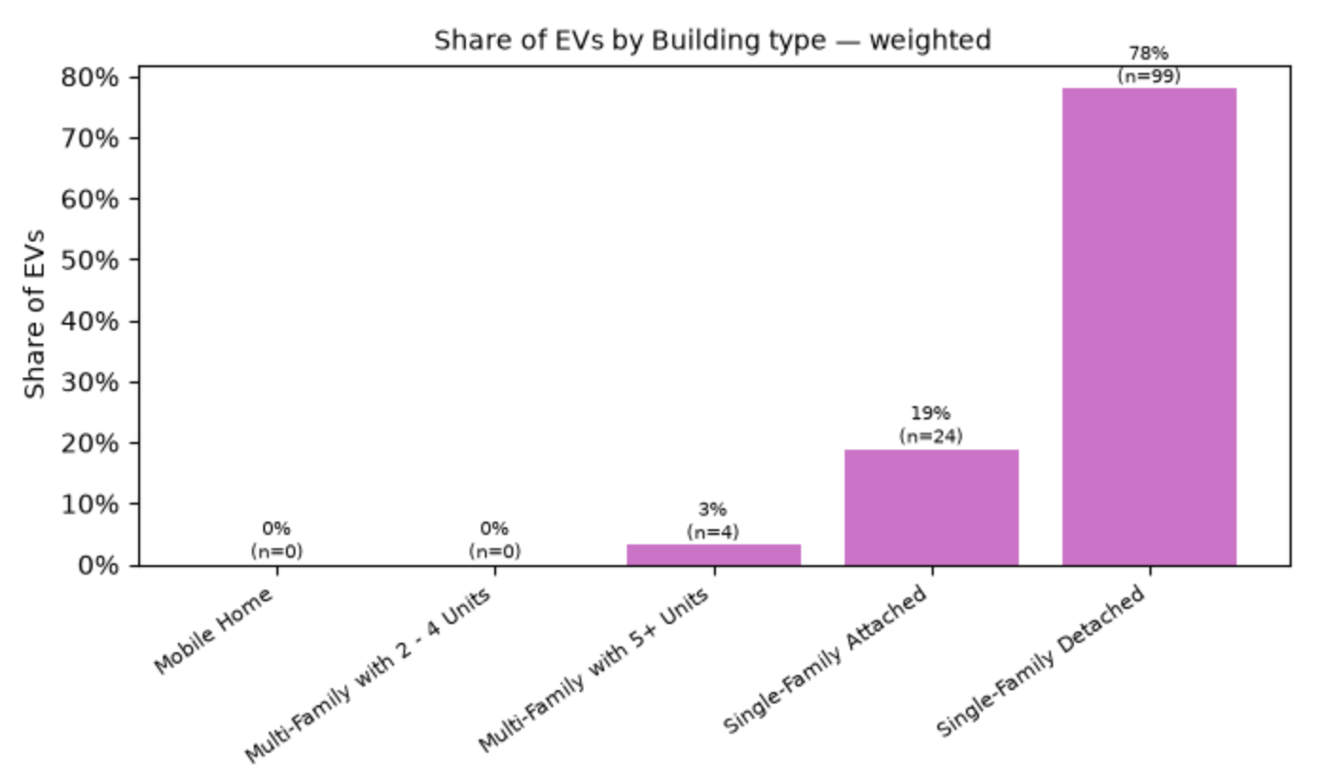
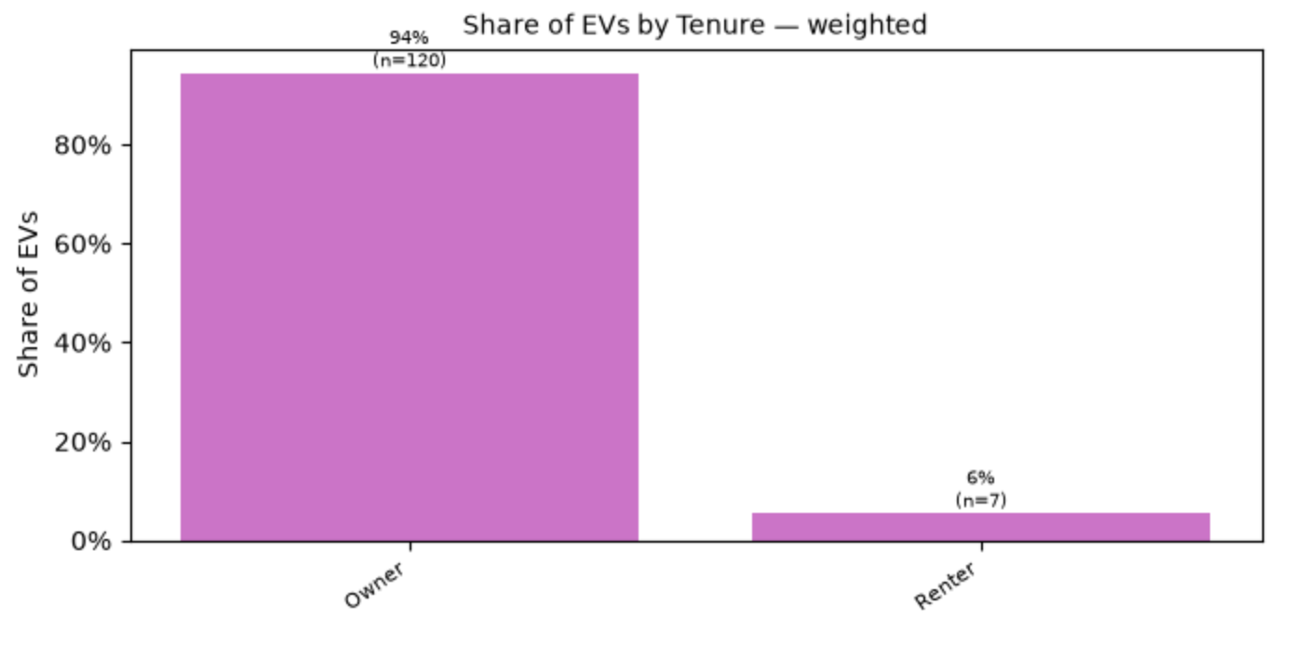
Step 1: Model EV Adoption
ResStock (2024) MD sampled EV ownership rates by segment (apply ResStock Building weights):
ResStock (2025) MD Sampled EV ownership rates by segment (apply ResStock Building weights):
Notes:
Add more visualizations along the way. Like visualize demographic data influencing trip profiles for example

Slide 6
Step 2: Assign Driving Profiles
Participants in NHTS (2022) logged all their trips over a 24-hour period:
Each trip log includes:
Start time
End time
Miles traveled
Match EV owners to NHTS weekday and weekend daily trip logs based on:
Urban/rural status
Income
Number of occupants
ResStock (2024) metadata_df:
bldg_id | urban | income | occupants | EV | weekday_vehicle_profile | weekend_vehicle_profile
3870 | 1 | 75k | 2 | 1 | (8,9,7.44), (17,18,6.97) | (8,9,1.46), (12,13,1.46), (15,16,4.24), (16,17,4.18)
14133 | 1 | 90k | 3 | 1 | (6,7,31.95), (15,16,29.10) | (4,5,3.00), (17,18,2.77)
22397 | 1 | 300k | 3 | 1 | (8,9,5.14), (18,19,4.94) | (10,11,19.56), (11,12,10.89), (12,13,0.87)

Slide 7
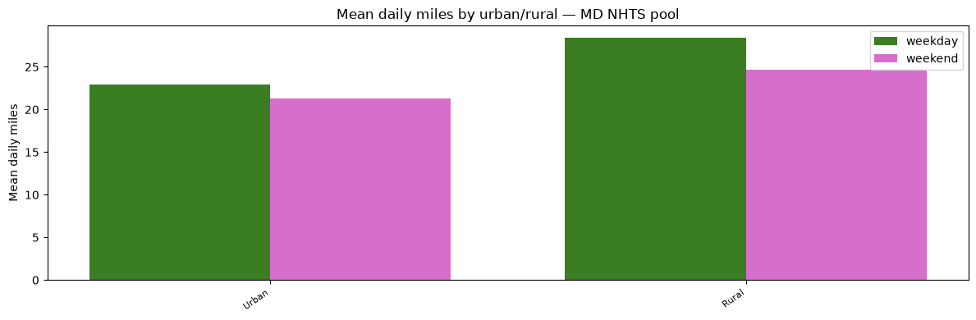
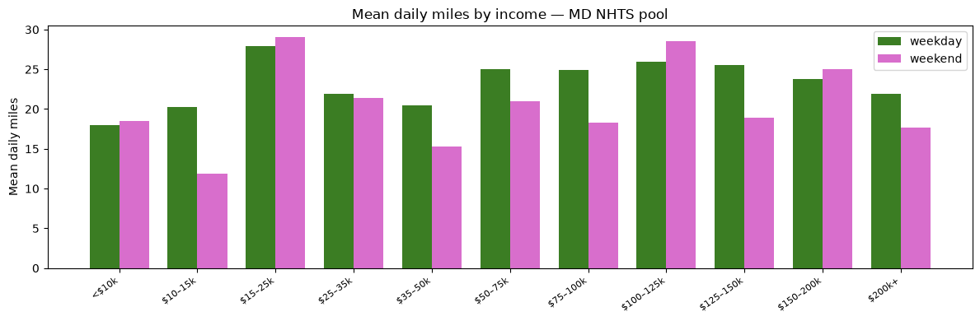
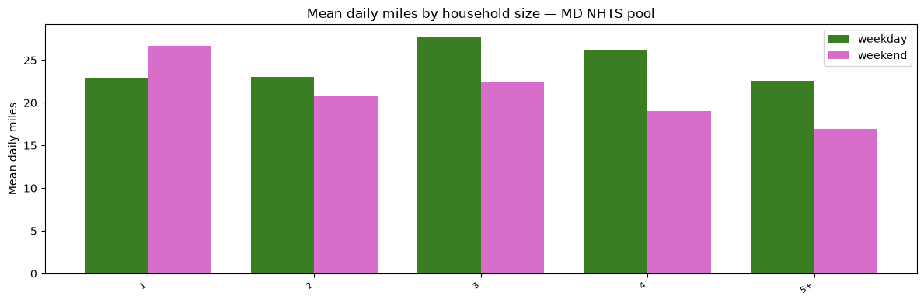
Step 2: Assign Driving Profiles
Daily miles of matched vehicle profiles to ResStock (2024) MD EVs:
Weekday match tiers:
Urban + Income + Occupants | 172
Urban + Income | 6
Weekend match tiers:
Urban + Income + Occupants | 157
Urban + Income | 21

Slide 8
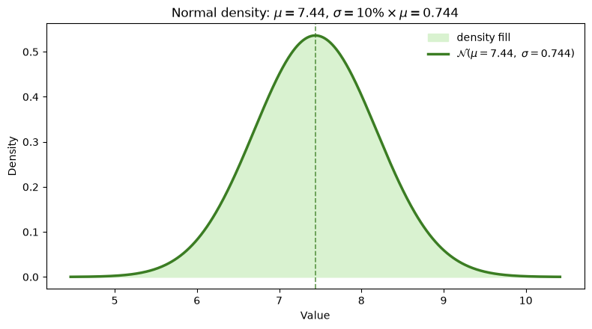
Step 3: Simulate Annual Travel
Generate an annual trip profile by stitching together random realizations from vehicle profiles.
bldg_id=3870 in ResStock (2024): weekday vehicle profile is (8,9,7.44), (17,18,6.97)
Monday, Jan 1, 2024:
Trip 1:
Draw random departure and arrival offsets from:
Draw miles traveled from:
~N(7.44, (0.744)^2)
-2 | -1 | 0 | 1 | 2
0.05 | 0.10 | 0.70 | 0.10 | 0.05
Repeat to get an annual travel schedule!
Notes:
See if we can compare our distribution of EV daily miles traveled against 2025

Slide 9
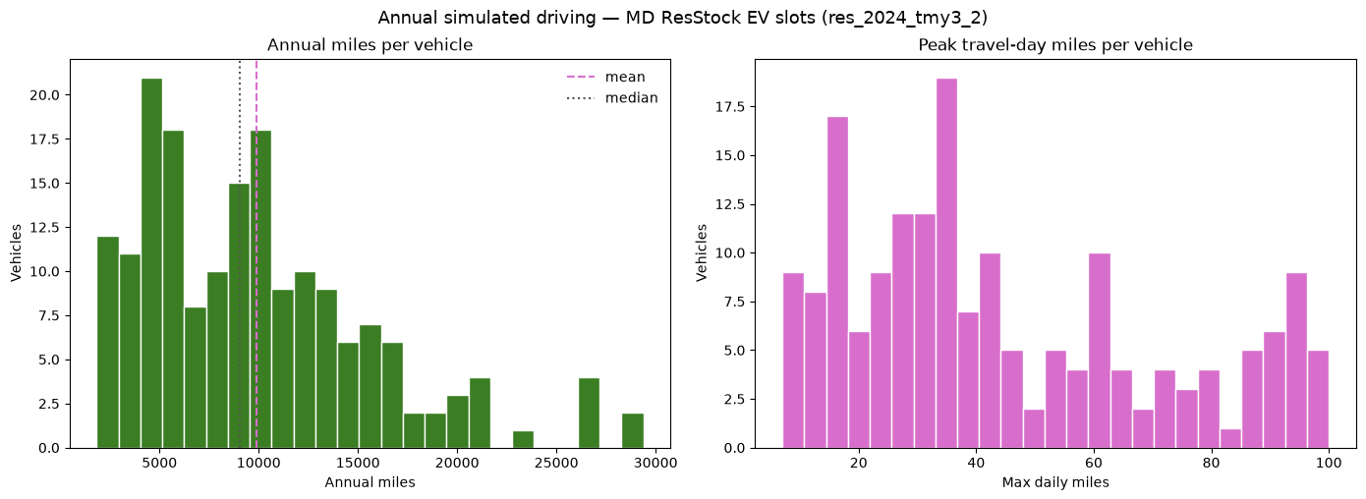
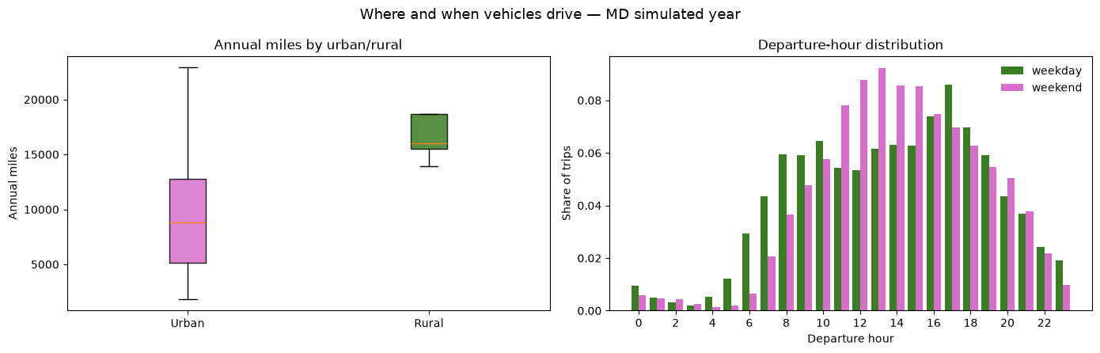
Step 3: Simulate Annual Travel
Summary of ResStock (2024) MD simulated annual travel profiles:
Notes:
See if we can compare our distribution of EV daily miles traveled against 2025

Slide 10
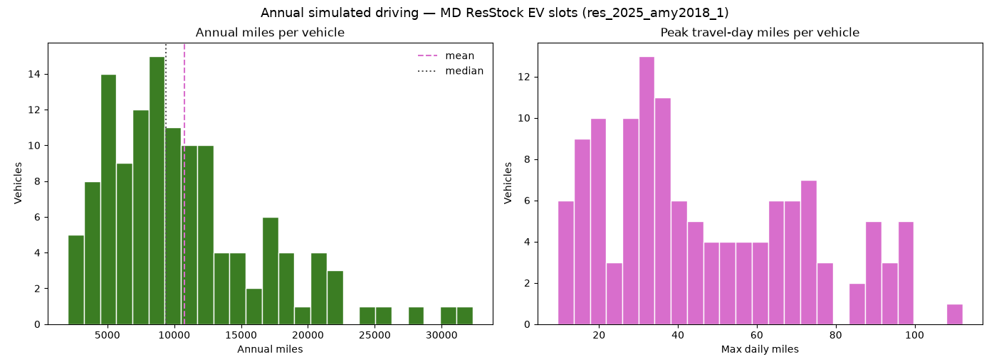
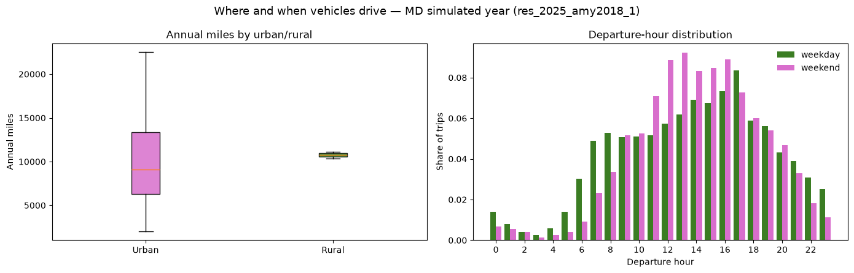
Step 3: Simulate Annual Travel
Summary of ResStock (2025) MD simulated annual travel profiles:
Notes:
See if we can compare our distribution of EV daily miles traveled against 2025

Slide 11
Step 4: Assign Vehicle Characteristics
ResStock (2025) allows for 7 EV types:
EV Types:
Compact (200 or 300 mi range)
Midsize (200 or 300 mi range)
SUV (200 or 300 mi range)
Pickup (300 mi range)
P(EV type | own EV)
Draw EV type from distribution of vehicle types that can cover max daily miles + 20% buffer.
ResStock (2024) metadata_df:
bldg_id | EV | max daily miles | EV option | capacity (kWh) | kWh/mi
3870 | 1 | 17.7 | SUV (300 mi) | 83.68 | 0.2789
14133 | 1 | 71.6 | Compact (200 mi) | 40.17 | 0.2099
22397 | 1 | 35.8 | SUV (300 mi) | 83.68 | 0.2789

Slide 12
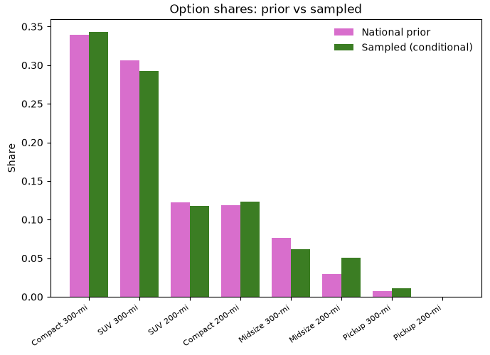
Step 4: Assign Vehicle Characteristics
EV Types in ResStock (2024) MD Sample:
Headroom (miles) = battery capacity (kWh) / efficiency (kWh/mi) – max daily miles
Mean | 219.78
Standard Deviation | 53.41
Minimum | 92.65
Maximum | 292.05

Slide 13
Assumptions in Steps 2-4
Assumptions:
One-to-one correspondence between NHTS participant travel schedule and vehicle trip profile.
NHTS surveys are filtered to consider one person’s trips in one vehicle.
Assumption: each EV is only driven by one owner.
Urban/rural flags in NHTS profiles are matched to in.puma_metro_status flag in ResStock data (which may not be exact).
Weekend and weekday travel profiles are different but they are consistent year round.
No explicit dependence between owning an EV and trip profiles.
E.g., EV owners might take shorter trips, or maybe they drive more because charging a car is cheaper than owning a gas-powered vehicle.
No correlation between EV schedule and rest of home base load (e.g., dishwasher, washing machine, HVAC, etc.)

Slide 14
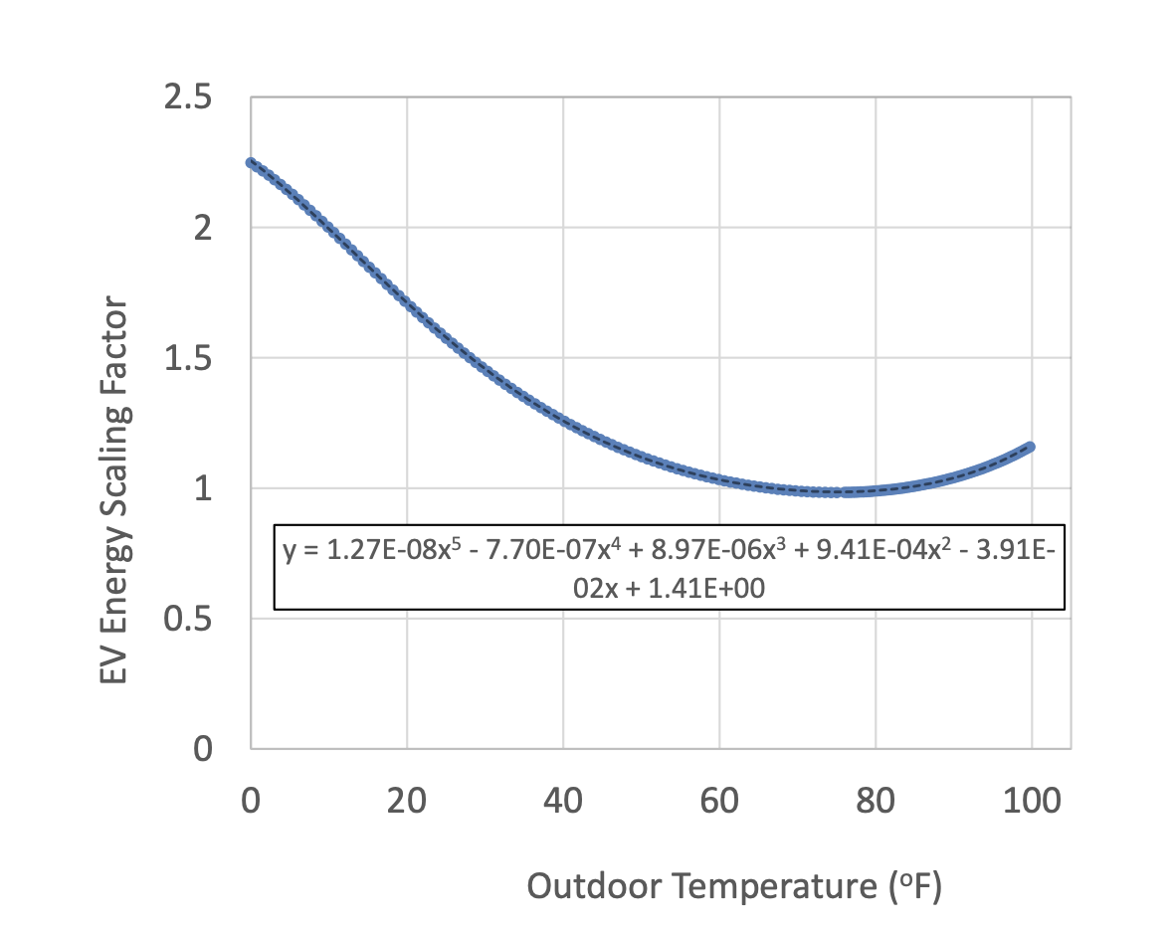
Step 5: Model at home/away & discharge
From each EV owner’s travel schedule + vehicle type, we can construct the table:
bldg_id=3870 in ResStock (2024):
Assumptions:
All trips start and end at home.
Miles are split uniformly among hours away.
Datetime | EV at home | Discharge (kWh)
Jan 1, 2024, 4am | 1 | 0
Jan 1, 2024, 5am | 1 | 0
Jan 1, 2024, 6am | 1 | 0
Jan 1, 2024, 7am | 1 | 0
Jan 1, 2024, 8am | 0 | 3.1207
Jan 1, 2024, 9am | 1 | 0
Jan 1, 2024, 10am | 1 | 0
Apply temperature scaling factor to get kWh discharged:

Slide 15
Step 6: Choose Charging Policy
bldg_id=3870 in ResStock (2024):
Assumptions:
Level 2 smart charger always available
Vehicle plugged in for entire duration of being home (for some policies)
Datetime | EV at home | Discharge (kWh) | Charge (kWh)
Jan 1, 2024, 4am | 1 | 0 | 83.68
Jan 1, 2024, 5am | 1 | 0 | 83.68
Jan 1, 2024, 6am | 1 | 0 | 83.68
Jan 1, 2024, 7am | 1 | 0 | 83.68
Jan 1, 2024, 8am | 0 | 3.1207 | 80.5593
Jan 1, 2024, 9am | 1 | 0 | 83.68
Jan 1, 2024, 10am | 1 | 0 | 83.68
Charging Policies:
Immediate
Off peak immediate
Off peak for next day
Lower bound

Slide 16
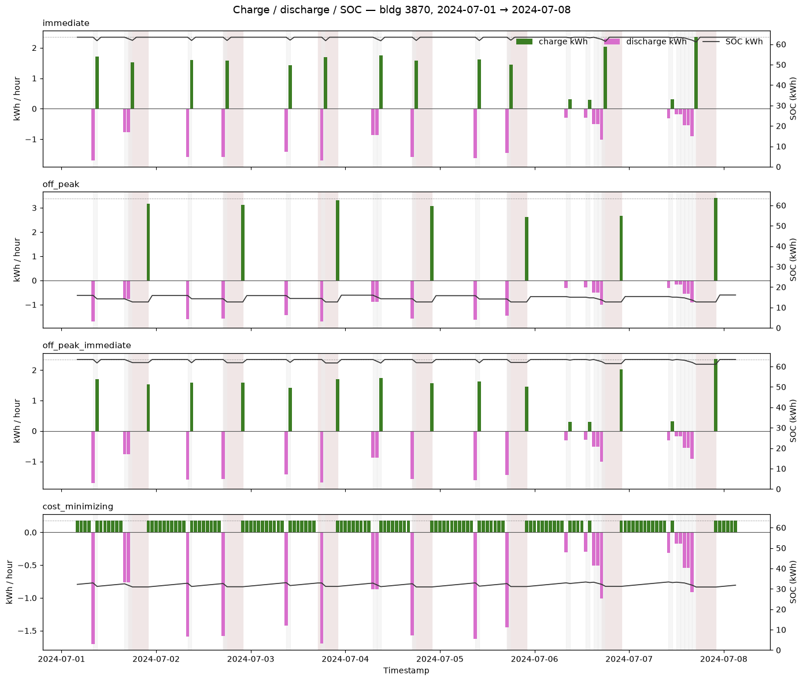
Step 6: Choose Charging Policy
bldg_id=3870 in ResStock (2024):
Load shedding:
If not enough charge to complete a trip, truncate trip kWh and suppose vehicle makes it home.
Flag hours with SOC underflow (current sample has no such hours).
In cost-minimizing LP, add (large) penalty for load shedding and track hours.
On-peak hours: 5:00pm-9:59pm

Slide 17
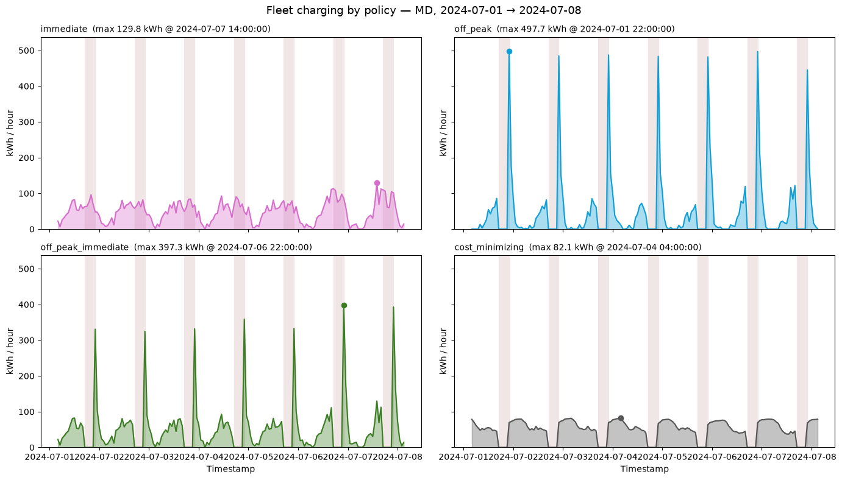
Aggregate Charging Load
ResStock (2024) MD EV aggregate charging load sample:
Peak Hourly EV Load (kWh)
Immediate | 154.03
Off-peak immediate | 439.36
Off-peak for next day | 533.31
Cost minimizing | 82.12

Slide 18
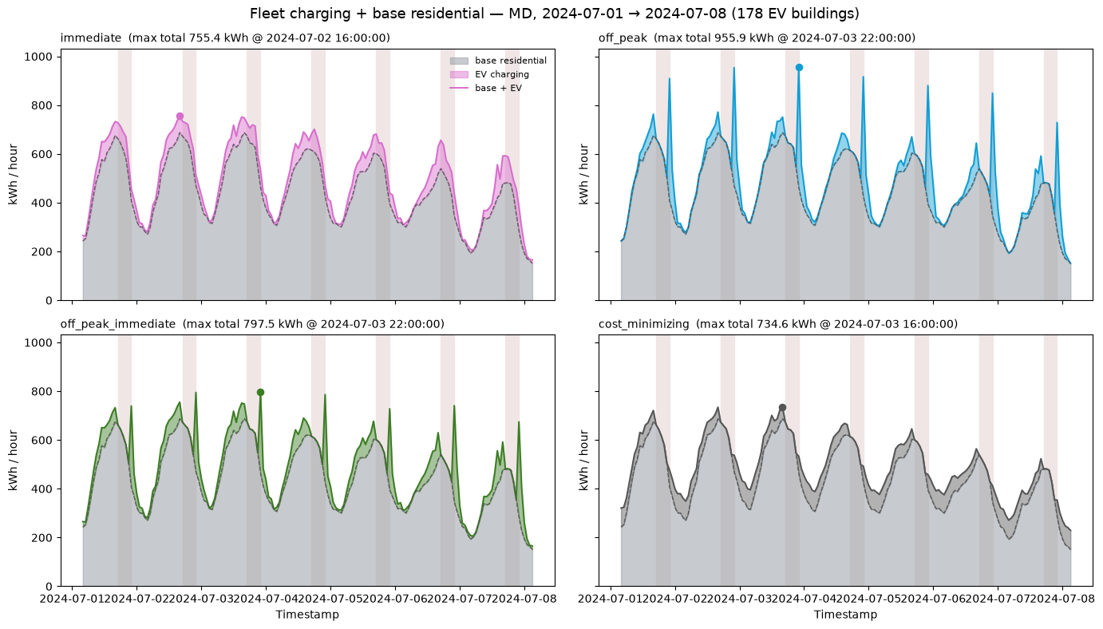
Aggregate Charging Load
ResStock (2024) MD EV aggregate charging load + base load sample:
Peak Hourly EV + Base Load (kWh)
Immediate | 981.75
Off-peak immediate | 1123.22
Off-peak for next day | 1220.27
Cost minimizing | 988.18

Slide 19
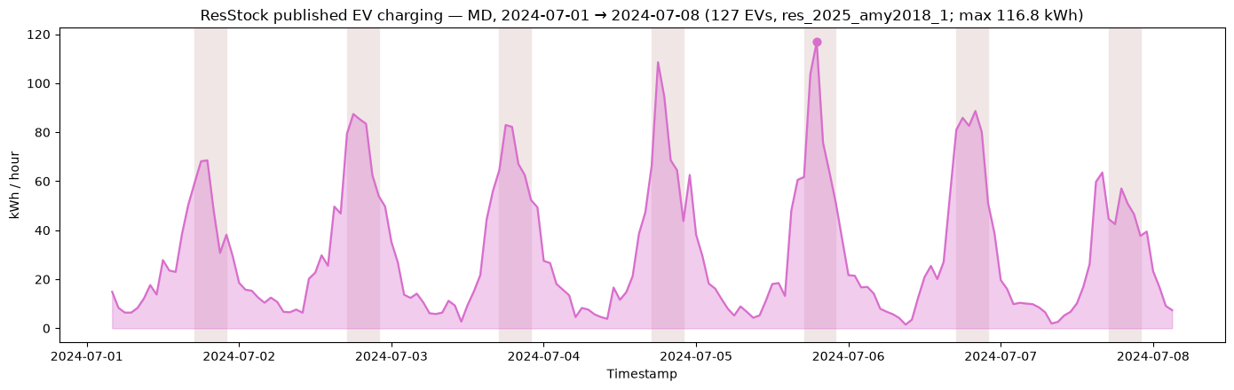
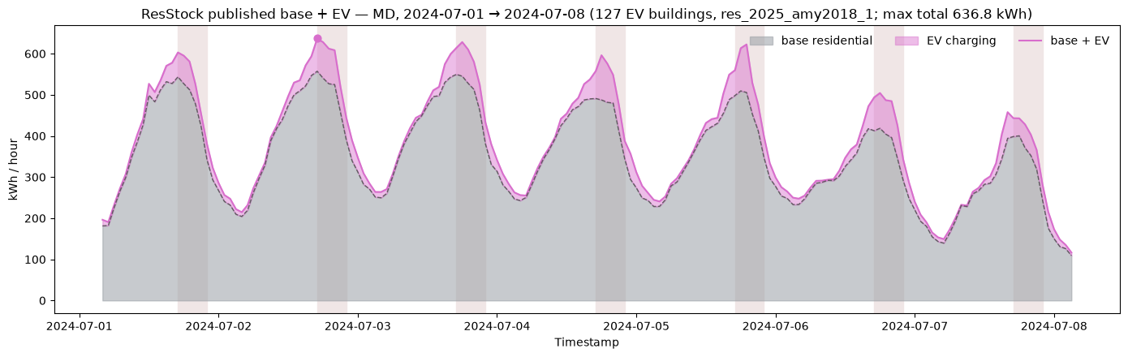
Aggregate Charging Load
ResStock (2025) MD EV aggregate charging load + base load sample:
Peak Hourly EV Load (kWh)
Immediate | 164.76
Peak Hourly EV + Base Load (kWh)
Immediate | 797.86

